Slide 1


WP3: Quality control, shelf-life and logistics
WP3 aims:
Specification of key characteristics for different types of ATMPs, including methods for analyzing and evaluating these
Increased knowledge of mechanisms and kinetics of changes in key characteristics of selected ATMPs
Materials and protocols for storing and transporting ATMPs with retained key characteristics
Explore new approaches for real-time monitoring of storage and transportation conditions of ATMPs

Slide 2
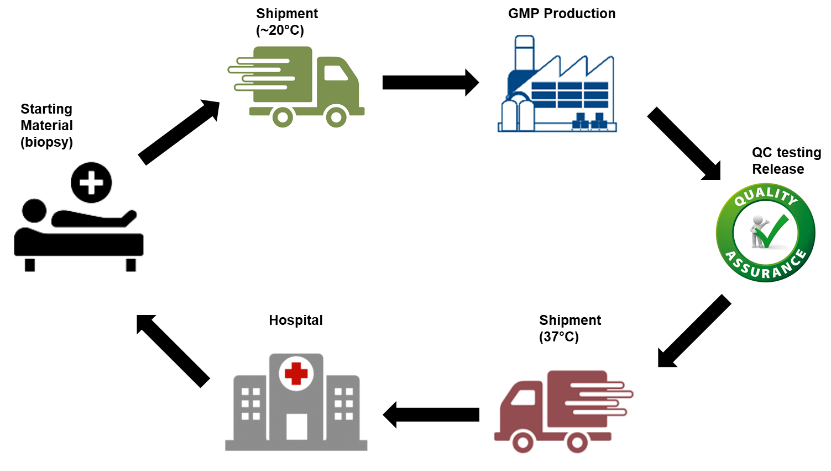
Impact of logistics on manufacturing strategy
Critical quality attributes should not be altered during shipping, freezing, thawing or storing
Fresh
If therapies do not allow freezing/thawing
Multiple manufaturing site
Need to contol regulatory, manufacturing equivalence, etc.
Cryo
Single large scale manufacturing site possible
Reduced cell viability
How to manage/control thaw

Slide 3
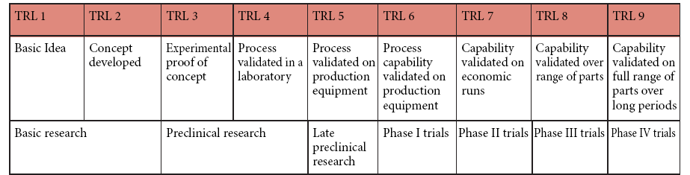
Think about strategy during development
Key to logistics success is designing in “quality” from the outset
Clinical development
Manufacturing development
Logistical development

Slide 4
WP 3
2018
2019
2020
2121
2022
2023
Q1
Q2
Q3
Q4
Q1
Q2
Q3
Q4
Q1
Q2
Q3
Q4
Q1
Q2
Q3
Q4
Q1
Q2
Q3
Q4
Q1
Q2
Q3
Q4
3.1 - Establishing a QC and logistics strategy of cell-based products for secure patient treatment – Jim Lund
3.4 – Generic logistics project with multiple stakeholders
3.2 - Single cell qPCR characterization of ATMP – Eva Bom
3.3 – Establishing a dryice based logistics strategy for cell therapies – Jim Lund
12
24
36
48
60
72
Ver200121

Slide 5
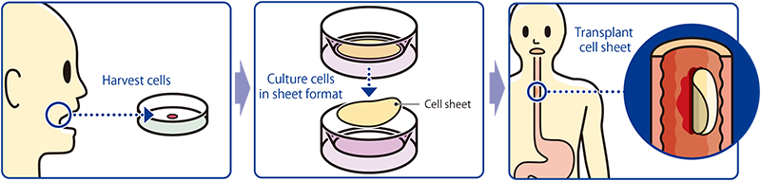




3.1 Establishing a QC and logistics strategy for autologous cell sheet
Establish suitable methods for QC testing
Identifying and validating the transportation for a proposed clinical trial

Slide 6
The shipping container must be fit for purpose
Qualification is an inspection and testing process used to establish that a piece of equipment or a physical installation is fit for purpose in the operational context within which it will be used.
There are typically 3 stages in the process:
    Design or installation qualification (DQ)
      Test of the container itself
    Operational qualification (OQ)
      Ambient temperature testing in lab
    Performance qualification (PQ)
      Conducted as a field test
      Must be successfully performed 3 times
Ref: WHO – technical supplement to technical report series, No. 961, Suppliment 12 and 13, 2015

Slide 7
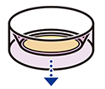


3.1 Establishing a QC and logistics strategy for autologous cell sheet
Establish suitable methods for QC testing
Identifying and validating the transportation for a proposed clinical trial

Slide 8
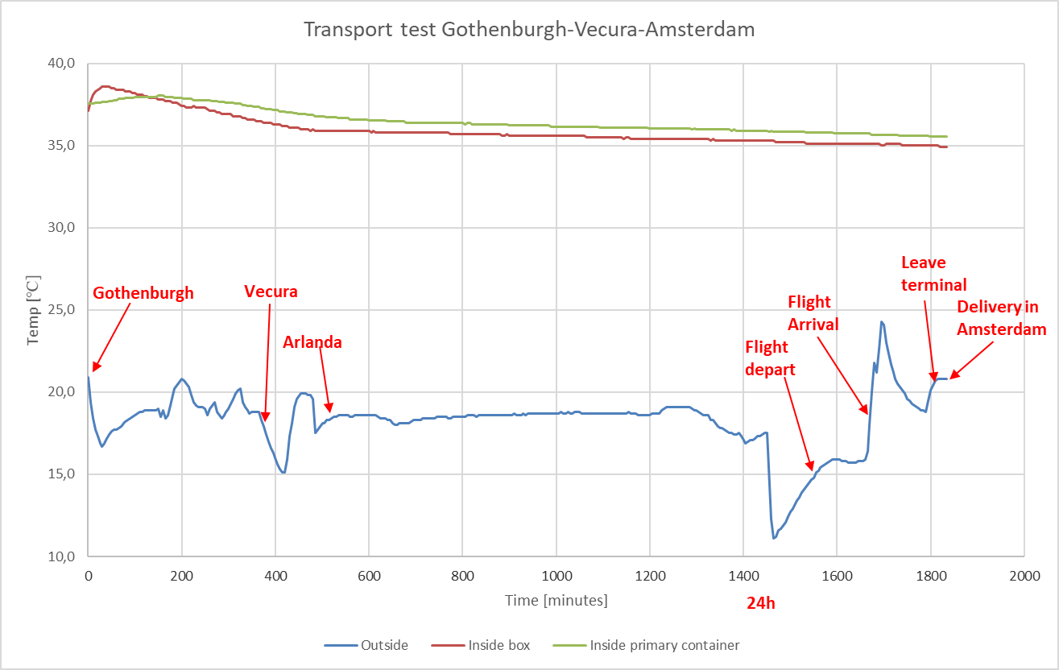
Collection of real world data during transport

Slide 9
3.1 Establishing a QC and logistics strategy for autologous cell sheet
Shipment of a product @~37⁰C with 48h shelf-life within EU is feasible

