Slide 1
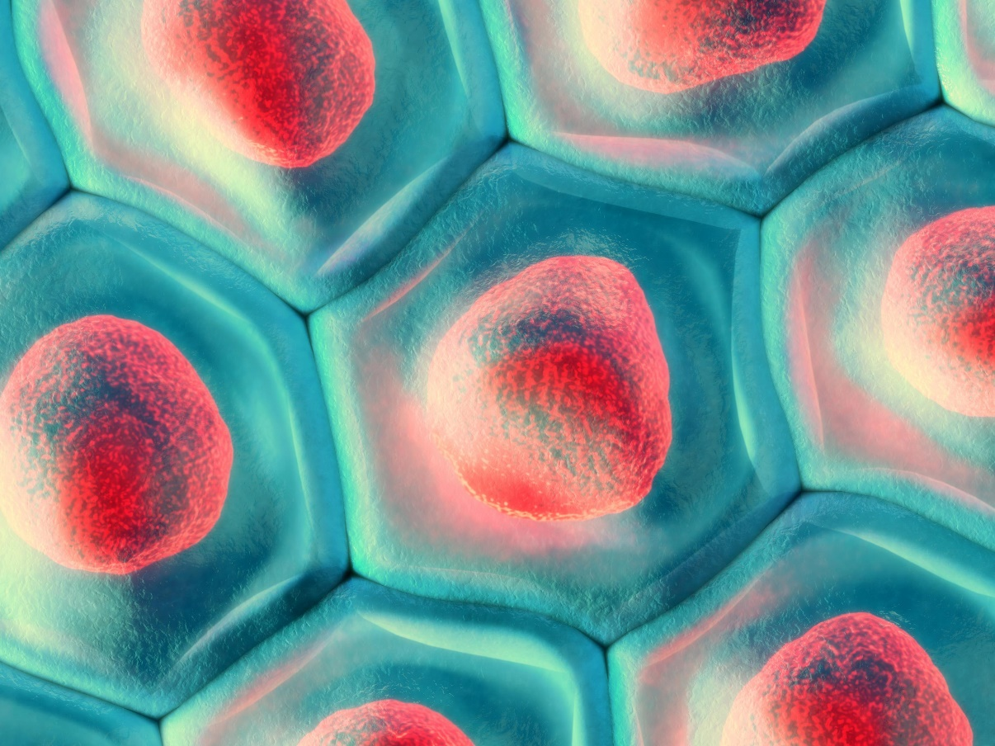
CAMP – A National Centre for Advanced Therapies
Driving technological developments, research translation and manufacturing capabilities to make Sweden a world leader in new medical products that use gene therapy, cell therapy, and tissue engineering
www.atmpsweden.se
Notes:
CAMP är ett centrum för utveckling en ny typ av läkemedel, så kallade ATMP.

Slide 2
What is an ATMP?
Advanced Therapy Medicinal Product (ATMP) – an EMA classification.
A new generation of medical products, based on genes, cells, and/or tissues, providing new opportunities for patients.
The development of these complex products involves a unique ecosystem requiring partnering between researchers, healthcare and industry.
Notes:
ATMP är avancerade terapiläkemedel som baseras på gener, celler och vävnadsprodukter.

Slide 3
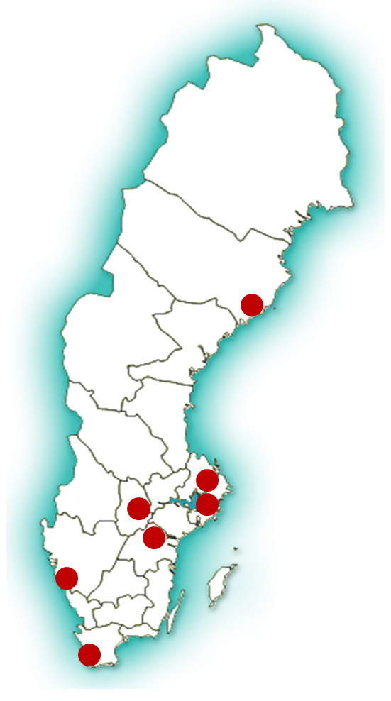
Centre for Advanced Medical Products Products
Facilitating and accelerating ATMP development in Sweden through technological developments, research translation, and increased manufacturing capabilities.
Partners from healthcare, industry and academia working together to bring breakthrough research to patients.
CAMP is a part of the ATMP Sweden network.
Notes:
Sjukvård, industri och akademi arbetar tillsammans för att ATMP skall nå hela vägen till patienter.

Slide 4
Focus areas of the Centre
Process Development: cell expansion and separation technologies, tissue engineering reconstruction, bioprinting, extracellular vesicles.
Infrastructure: pre-GMP and GMP facilities for development and manufacturing of ATMPs for early stage clinical trials.
Logistics: Quality control, shelf-life and characterisation of ATMPs.
Support around system challenges: regulatory, health economy, ethics and legal aspects.
Notes:
Centrumet fokuserar på teknologi och produktutveckling, samt utmaningar kring regelverk och hälsoekonomi.

Slide 5
What does CAMP offer?
A network of researchers, product developers, regulatory experts and manufacturing facilities offering:
Knowledge
Competence
Infrastructure
Collaborations
See more at www.atmpsweden.se www.linkedin.com/company/atmpsweden
Contacts: Jukka Lausmaa (Centre Director) jukka.lausmaa@ri.se
Kristina Kannisto (Project Manager) kristina.kannisto@sll.se
Paul Kingham (Coordinator) paul.kingham@umu.se
Notes:
CAMP erbjuder ett nationellt nätverk för ATMP-utveckling. Kontakta oss gärna, läs mer på vår hemsida och följ oss på LinkedIn.

