Slide 1
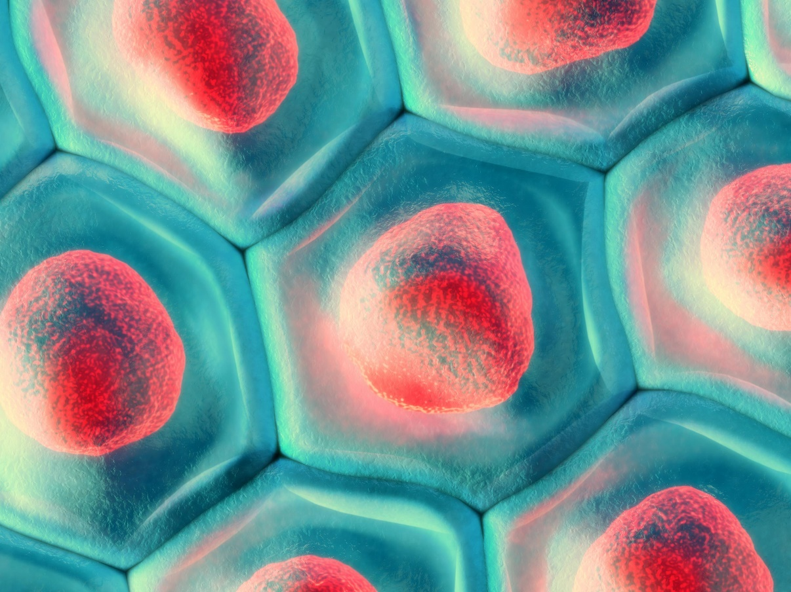
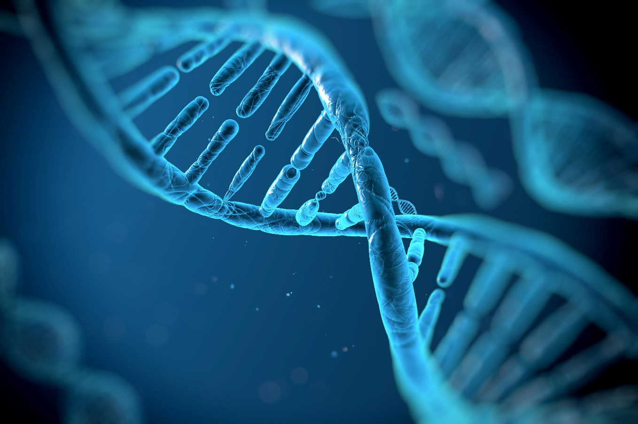
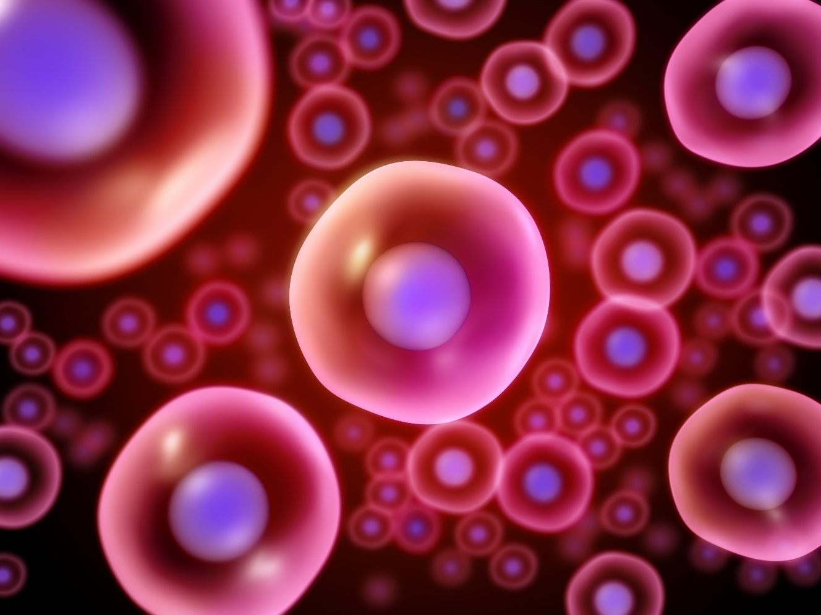
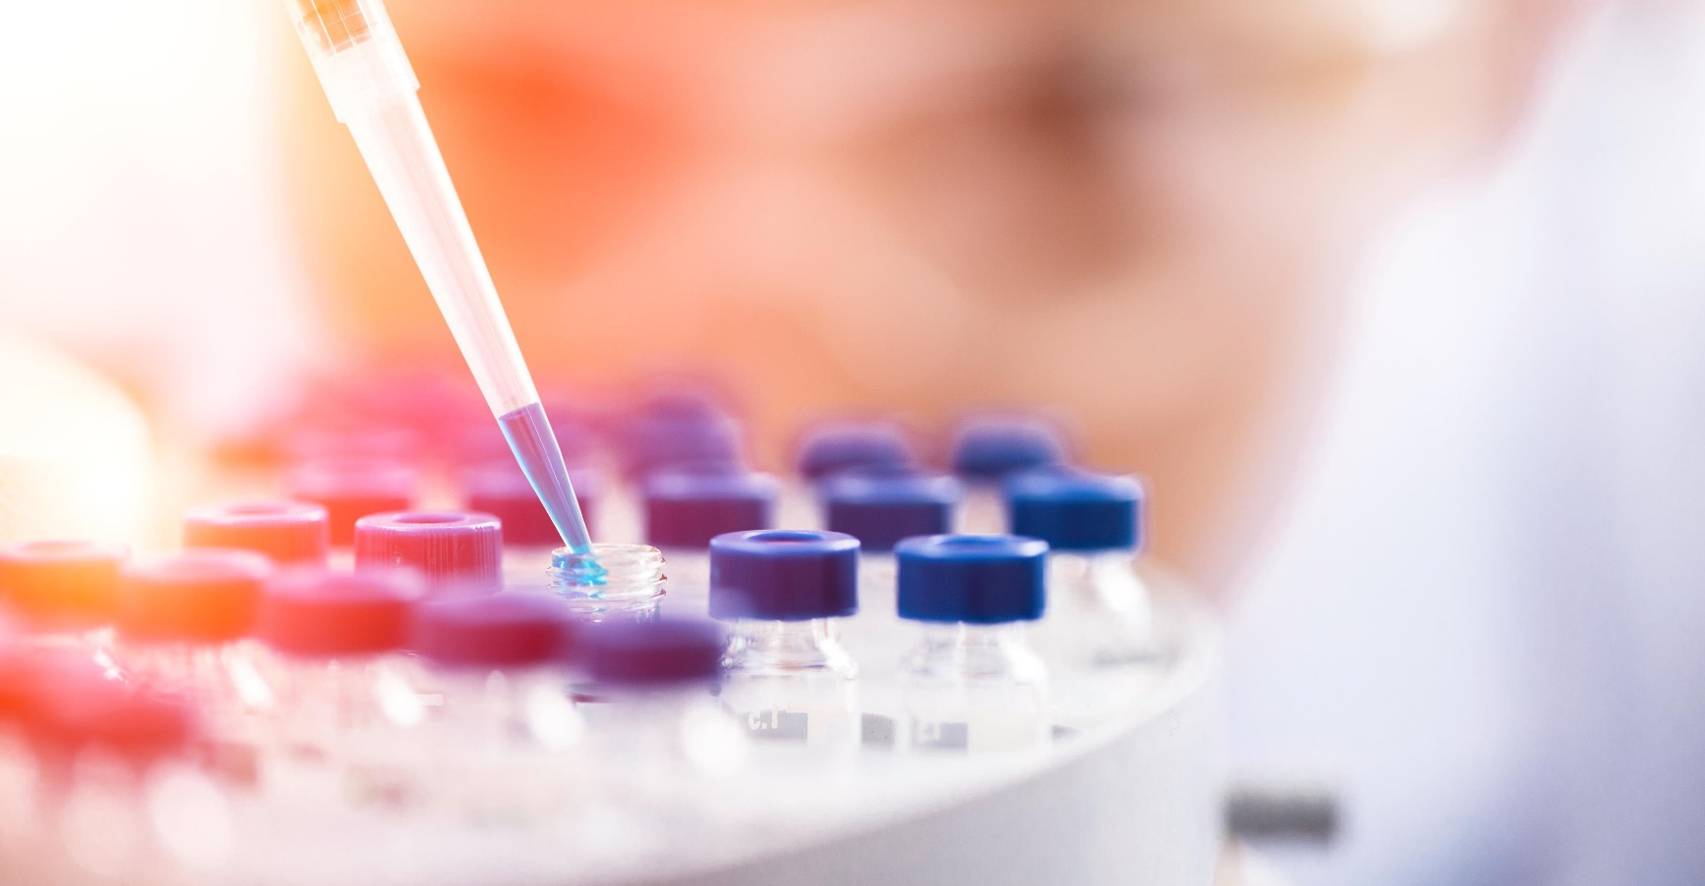
What are ATMPs?
New generation pharmaceuticals based on cells, gene therapy or tissue replacement
www.atmpsweden.se
Notes:
CAMP är ett centrum för utveckling en ny typ av läkemedel, så kallade ATMP.

Slide 2
What are ATMPs?
New generation pharmaceuticals based on cells, gene therapy or tissue replacement
Novel technologies giving new options for disease treatments
Pharmaceuticals
Synthetic pharmaceuticals eg. aspirin, panadol 1869
Biologics
Pharmaceuticals manufactured from cells eg. insulin, Keytruda 1982
Advanced Therapy Medicinal Products (first EMA approved 2009)
Cell or gene based pharmaceuticals
Eg. CAR T, Strimvelis
Curing disease by replacing diseased cells/tissues or correcting diseased genes
Treating disease by adding cells or genetic material (DNA/mRNA)
Removing defective cells by programming the body to attack them
Notes:
What are ATMPs from a lay perspective

Slide 3
ATMPs – new pharmaceuticals using human cells and/or genes
ATMPs
What can ATMPs do?
Manufactured
Correct patient DNA
Treat disease by adding mRNA
Add gene corrected cells
Instruct the body to kill defective cells eg. CAR T
Replace diseased cells/tissues
Treat/prevent disease by adding cells
Cut/paste gene technology
Transplant for different biological function
Human cells or tissues
Notes:
What are ATMPs from a lay perspective

Slide 4
What are ATMPs?
European Medicines Agency classification of cell or gene therapy based pharmaceuticals
Regulation came into effect 2007, first drug approved 2009
Medicinal products
Synthetic pharmaceuticals eg. aspirin, panadol 1869
Biologics
Pharmaceuticals manufactured from cells eg. insulin, Keytruda 1982
Advanced Therapy Medicinal Products (ATMP) – pharmaceuticals based on;
Technology to modify patient genome
Recombinant nucleic acids or genes
Substantially manipulated cells
Cells intended for a non-homologous function
Engineered tissue
Notes:
What are ATMPs from technology perspective

Slide 5
What are ATMPs?
Every ATMP starts with either donor/patient cells and/or recombinant gene technology
Recombinant (cut and paste) gene technology
Notes:
What are ATMPs from a technology perspective

Slide 6
ATMPs
Medical Devices
(93/42/EEC)
Biologics Medicinal Products (2001/83/EC)
Type of treatment/product modality
Medical Devices
Tissue Therapy
Cell Therapy
Gene Therapy
Vaccines
Biotech
Chemicals
Advanced Therapy Medicinal Products (ATMP) (1394/2007)
eg. DNA vaccines or recombinant virus AGAINST infectious disease
eg. Insulin, antibodies, EV with transgenic protein
Combined ATMP
medical device plus a TEP, sCTMP or GTMP
Tissue Engineered Product (TEP)
eg. Spherox, lab grown skin for burns treatment, P-TEV (Verigraft)
Somatic cell therapy medicinal product (sCTMP)
eg. Holoclar, Alofisel, lab expanded blood stem cells…..MSC for arthritis
Gene Therapy Medicinal Product (GTMP)
eg. Kymriah, Imlygic, EV with recombinant mRNA, ILP100, in-vitro transcribed mRNA
eg. Aspirin, Spinraza
Synthetic oligonucleotide, legally speaking, are not gene therapies
By EMA legal classification all gene therapies are GTMPs
eg. medical device only, deceullarised scaffold
Tissues and Cells (2004/23/EC), Blood (2002/98/EC)
eg. skin transplant for burns treatment
eg. bone marrow transplant, blood transfusions
NOT ATMPs
Orphan drugs? – Örjan Norberg
ATMP Sweden
https://medium.com/termisbpc/termis-pap-session-3-regulation-of-advanced-therapeutic-medicinal-products-atmps-in-europe-fd7f883a9c81
https://slideplayer.com/slide/6287345/
https://ct.catapult.org.uk/sites/default/files/publication/DanRabbie_Taking%20Advanced%20Therapy%20Medicinal%20Products%20%28ATMPs%29%20to%20Market_29Jun18.pdf
Notes:
What are ATMPs from a regulatory perspective

