Slide 1
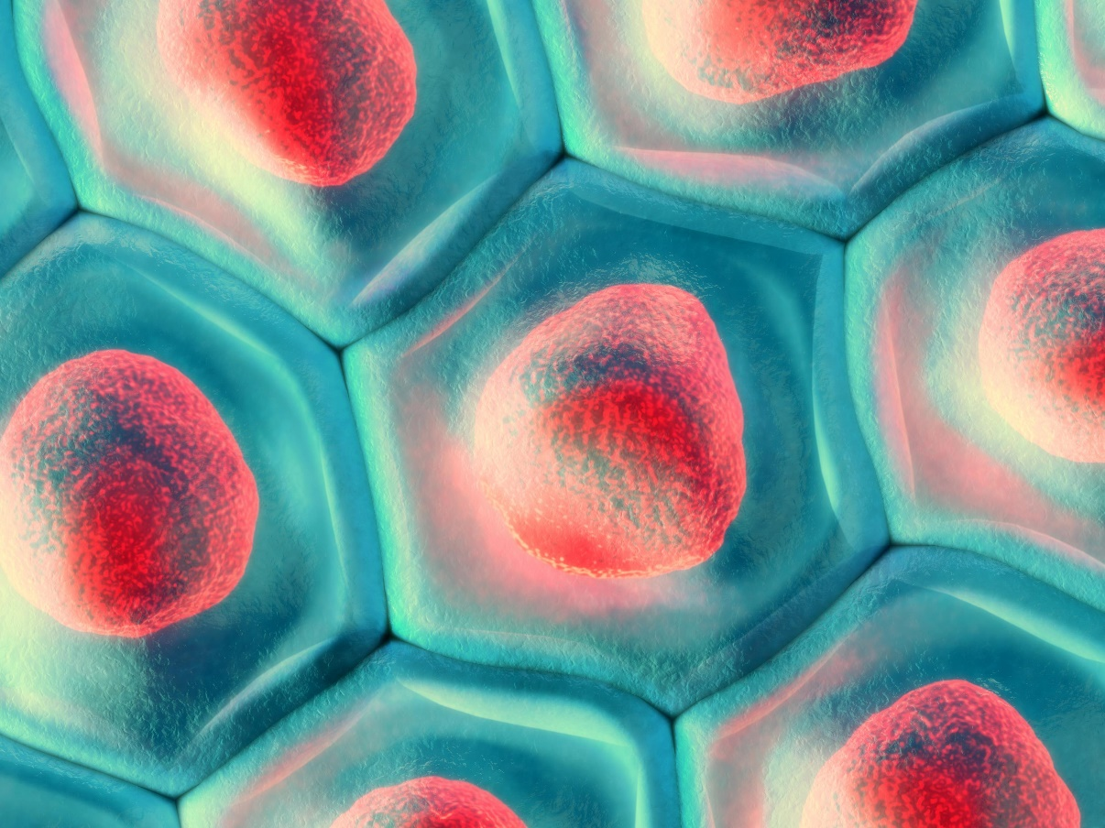
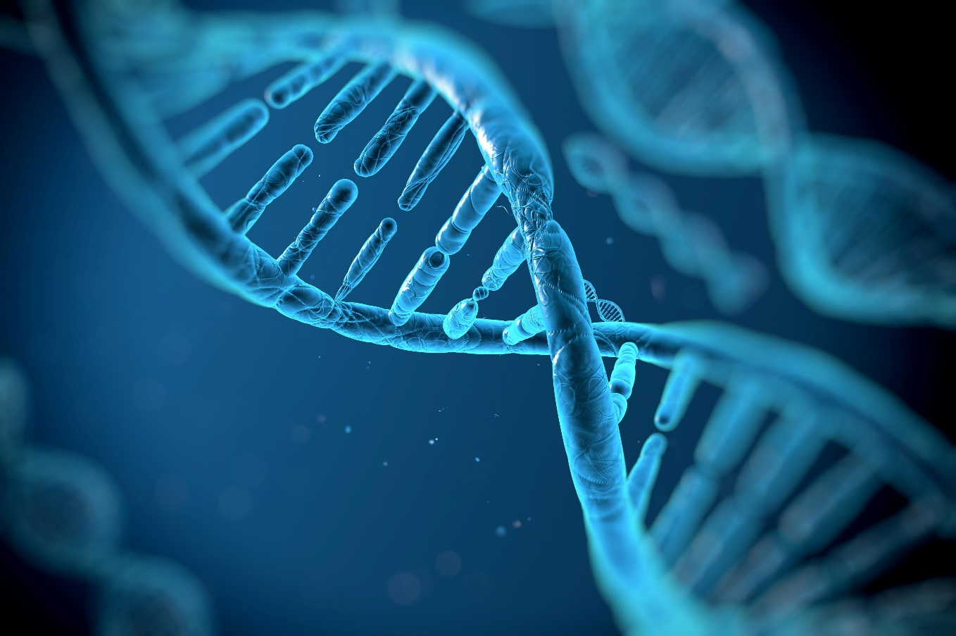
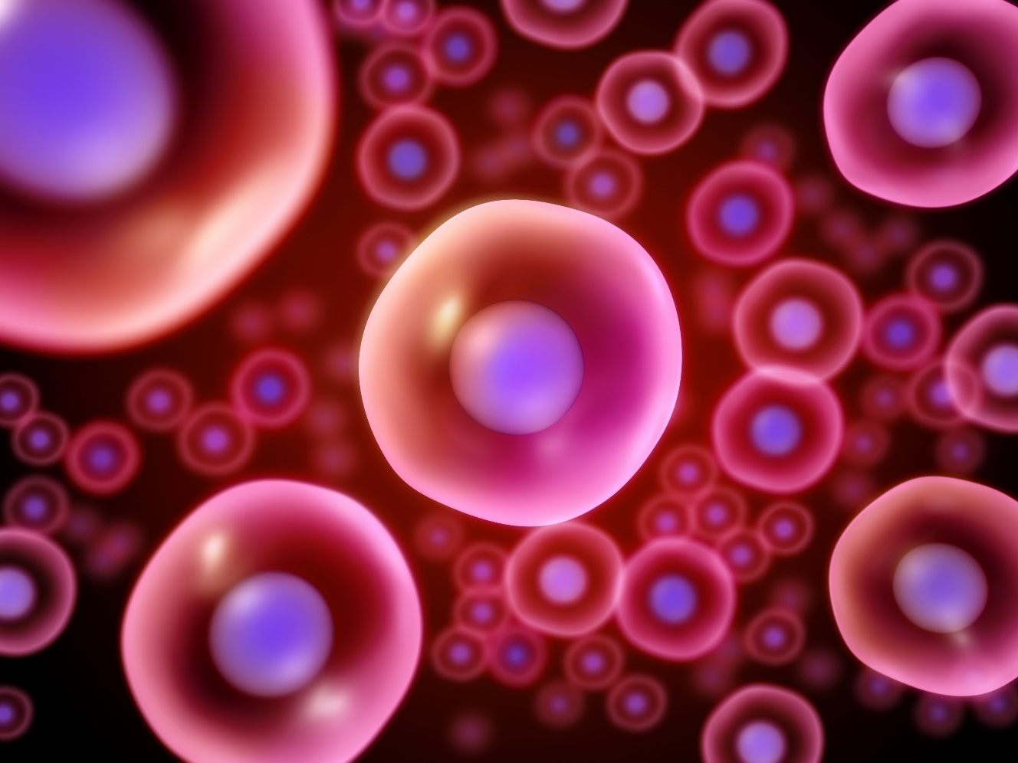
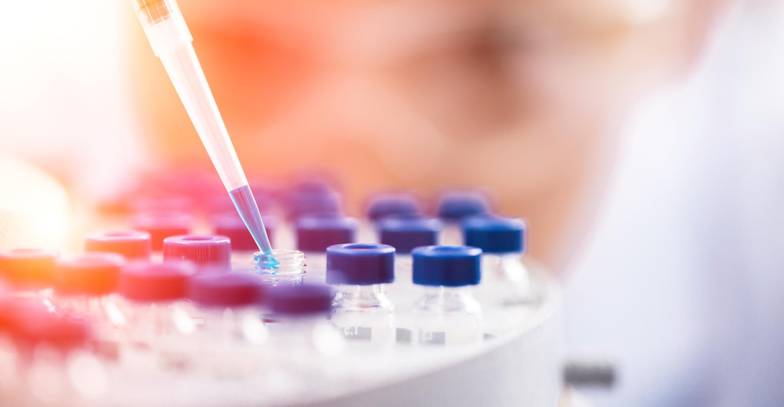
Introduction to ATMPs
Notes:
CAMP är ett centrum för utveckling en ny typ av läkemedel, så kallade ATMP.

Slide 2
Generations of pharmaceuticals
First synthetic pharmaceutical product is discovered
Synthetics are small molecule products produced by chemical synthesis. Current day synthetics include aspirin and paracetamol.
1869
First biologic pharmaceutical product is approved
Biologics are products manufactured from, or using, cells and living organisms. Examples include proteins and antibodies.
1982
First ATMP is approved by the FDA
Advanced therapy medicinal products (ATMP) are cell or gene based therapies. An example is Kymriah. All ATMPs include biologic elements.
2009

Slide 3
An ATMP is a living therapy.
ATMPs are unique since they are based on live material that is engineered or used in a new way that provides therapeutic effect

Slide 4
ATMPs can achieve what has previously been considered impossible
ACTION
OUTCOME
Instructing to kill defective cells
Cure diseases
Replacing cells or tissues
Prevent diseases
Correcting faulty patient DNA
Adding manipulated cells
Treat diseases

Slide 5
Simplified definition of ATMPs based on EMA regulations
Advanced therapy medicinal product (ATMP) is an umbrella term for four subtypes of advanced therapies.
The four subtypes of ATMPs are comprised of three distinct subtypes, and a fourth combination subtype.
Gene therapy
(GTMP)
Somatic cell therapy (sCTMP)
Tissue engineered product (TEPs)
Combined ATMP
The active substance must be a recombinant DNA (DNA that is created in the laboratory, bringing together DNA from different sources).
The recombinant gene can be administered to cells in vivo or ex vivo, meaning in the human body or outside of it.
It must have a direct therapeutic, preventative or diagnostic effect.
The active substance must be cells that are either significantly manipulated, or donated cells that have a different main function in the recipient.
The purpose must be to treat, prevent or diagnose a disease.
The active substance must be cells or tissues that are either substantially manipulated or that have a different main function in the recipient.
The purpose must be to repair, regenerate or replace human tissue.
A therapy that must incorporate at least one medical device, in combination with one of the three other subtypes.

Slide 6
Novel tech gives rise to new treatments
GTMP
KYMRIAH
Kymriah is an ex-vivo gene therapy for leukemia. The patients own cells are extracted, genetically modified and then reinserted.
sCTMP
APLIGRAF
Apligraf is a cell therapy for wound ulcers. It works through growth factors being secreted from transplanted tissue to support formation of new skin.
TEP
Holoclar is a treatment where stem cell are used to replace damaged cells on the surface of the cornea of the eye.
HOLOCLAR
Combined
PEC-Encap is a combined treatment for diabetes. Matured stem cells are loaded into a device, where they produce insulin to regulate glucose level.
PEC-ENCAP

Slide 7
The type of ATMP can be definied from its origin and development steps
Every ATMP is based on either cells from a donor and/or patient, and/or from recombinant gene technology
Replace, repair or regenerate human tissue
TEP
Cells collected from donor or patient
Not treated using recombinant DNA
Substantially manipulated cells or cells that serve a new function/use
Treat, prevent or diagnose a disease
sCTMP
Treated using recombinant DNA
ex-vivo
GTMP
Recombinant gene technology
The recombined
DNA is added to cells extracted from
the body
Combining DNA from different
sources
The recombined
DNA is added to cells
inside the body
in-vivo
GTMP
Notes:
What are ATMPs from a technology perspective

Slide 8
ATMPs from an EU regulatory perspective
Therapy Type
Aspirin, Spinraza
Regulations that apply
Examples
Type of product
Small Molecules
Protein
Blood transfusion, bone marrow transplant
Medicinal Products
(2001/83/EC)
Tissues and Cells (2004/23/EC), Blood (2002/98/EC)
DNA vaccine against infectious disease
Biologics
Non-living Biologics
Kymriah, Zolgensma
Transplant and Transfusion*
Vaccines
Apligraf
Holoclar
ATMP
ATMP
(1394/2007)
Gene Therapy
Somatic Cell Therapy
PEC-Encap
Pacemaker, insulin pump
Tissue Engineered Products
Combined ATMP
Medical device
Medical device (93/42/EEC)
Medical Device Only
*Note: Not a Medicinal product

Slide 9
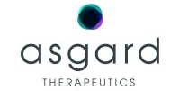
57% of the 35 identified ATMP companies are located in Sweden
35 ATMP companies were identified and defined as SMEs in the Nordic region.*
Sweden holds the most companies and of these, sCTMP is the most frequent ATMP focus area.
Norway
Finland
Sweden, including distribution of focus area
Denmark
4
companies
3
companies
20
companies
8
companies
**
*SME companies are defined by being founded and having their main operating activity in the Nordics. Their maturity level varies, but all have development programs in preclinical or clinical stage and have no marketed products.
** Lipigon has their only ATMP asset out-licensed to Combigene.
Sources: MSC analysis based on publicly available data

Slide 10
www.atmpsweden.se

